Slide 1


BANK OF
SUBURBS
Java Based
Bank Management System Project

Slide 2


AGGREGATION / INTEGRATION
COMPOSITION
Bank HAS Employees
Bank HAS Customers
Customer HAS Accounts
Account HAS Transactions
INHERITANCE
Full-Time IS AN Employee
Part-Time IS AN Employee
Savings IS AN Account
Checking IS AN Account
Fixed-Deposit IS AN Account

Slide 3
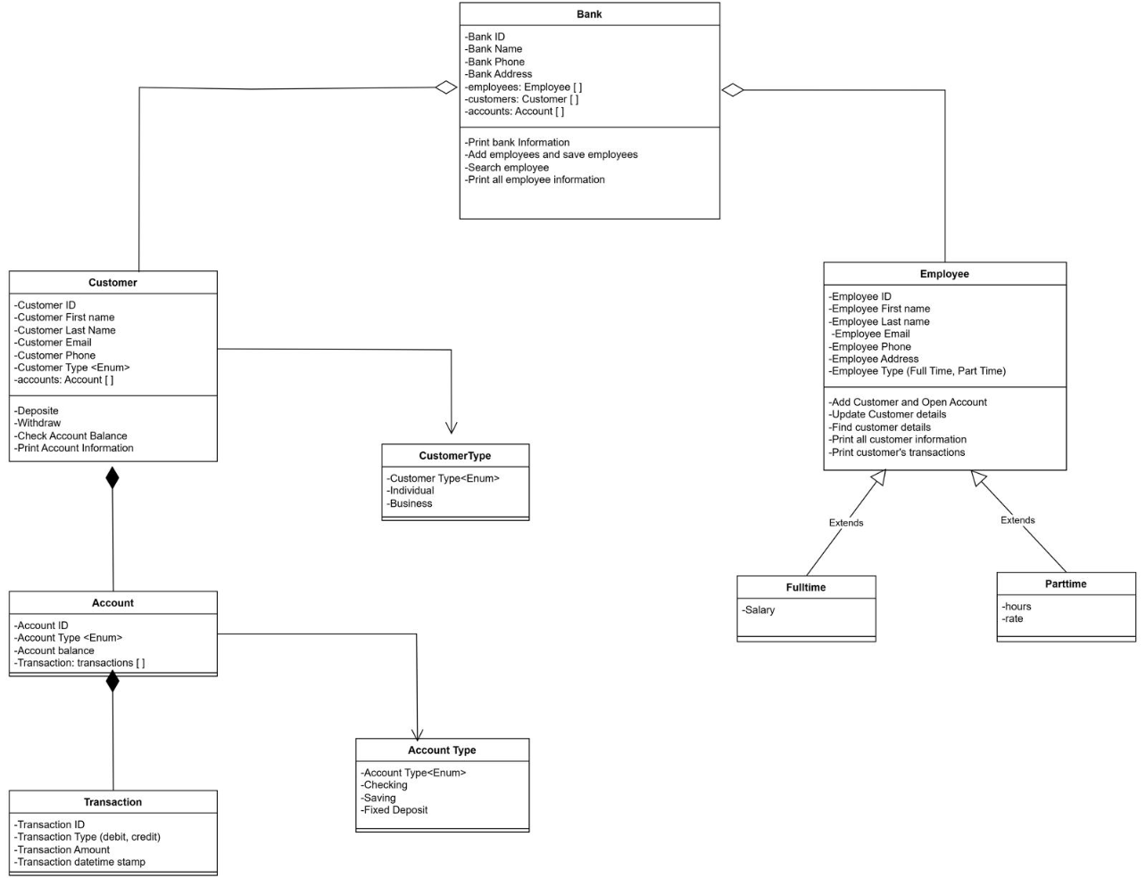
CLASS DIAGRAM

Slide 4
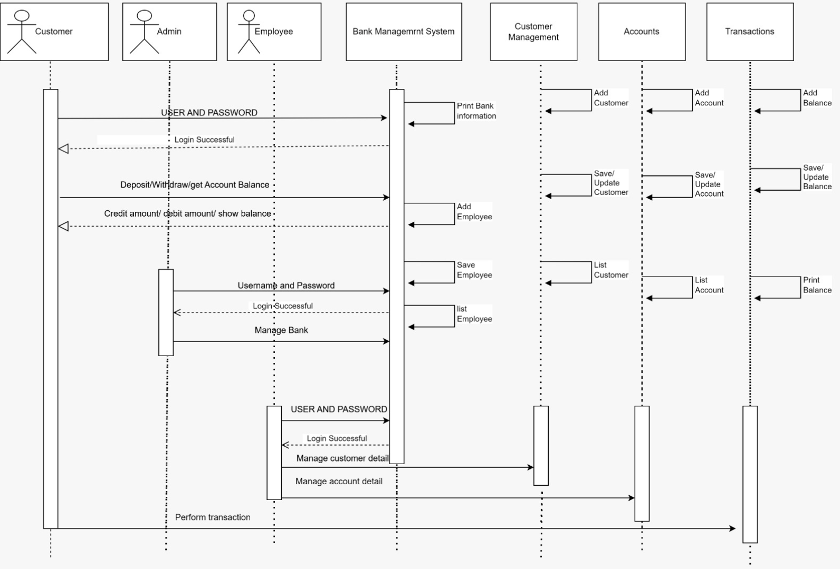
SEQUENCE DIAGRAM

Slide 5
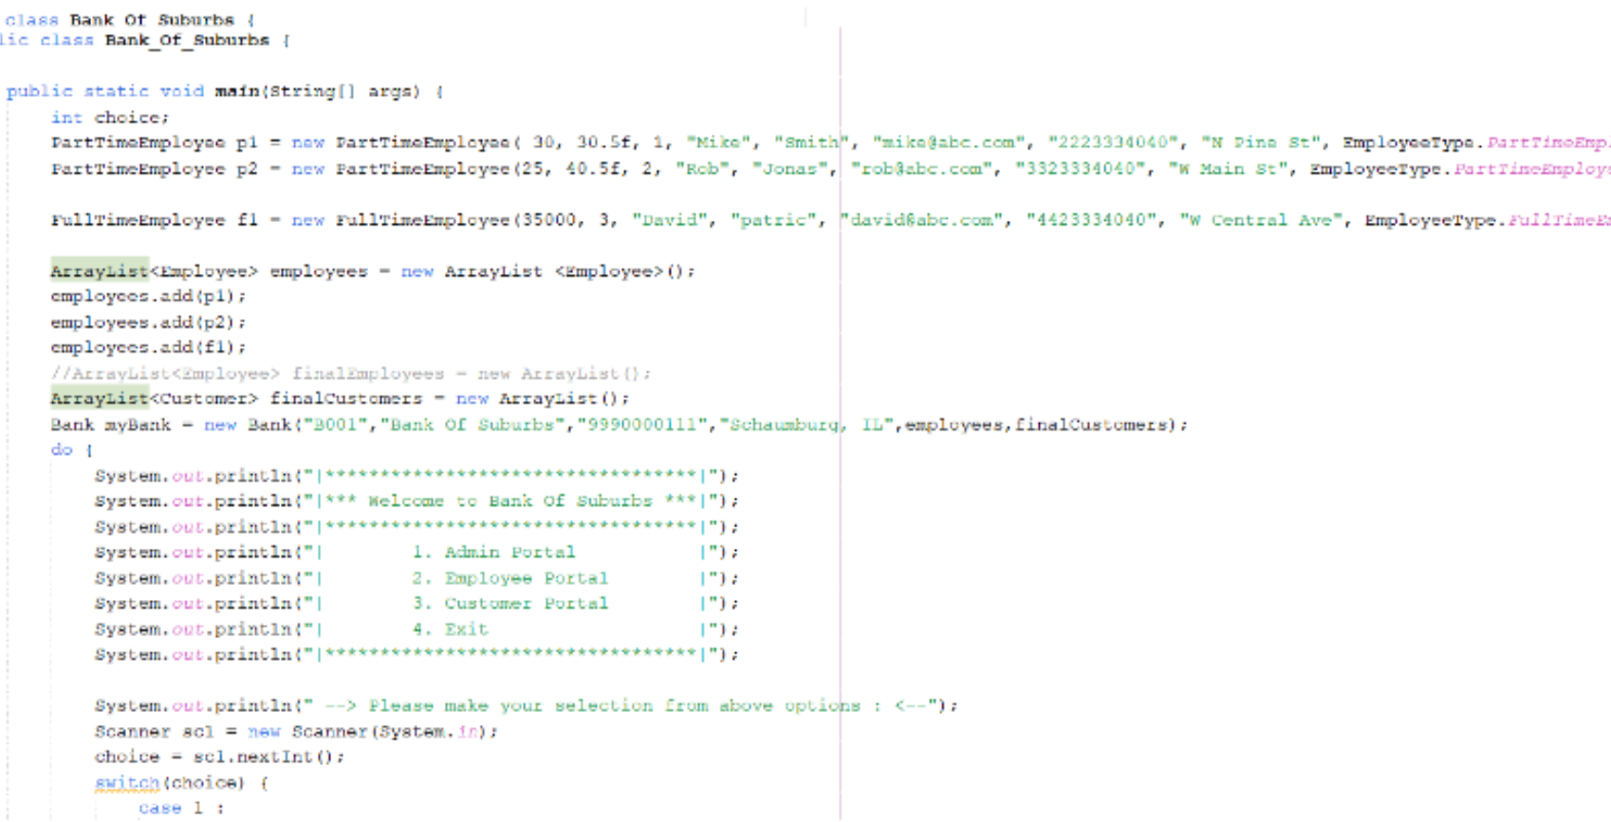

BANK DRIVER CLASS
Driver class acts as main menu that directs users to their respective functions based on account type

Slide 6

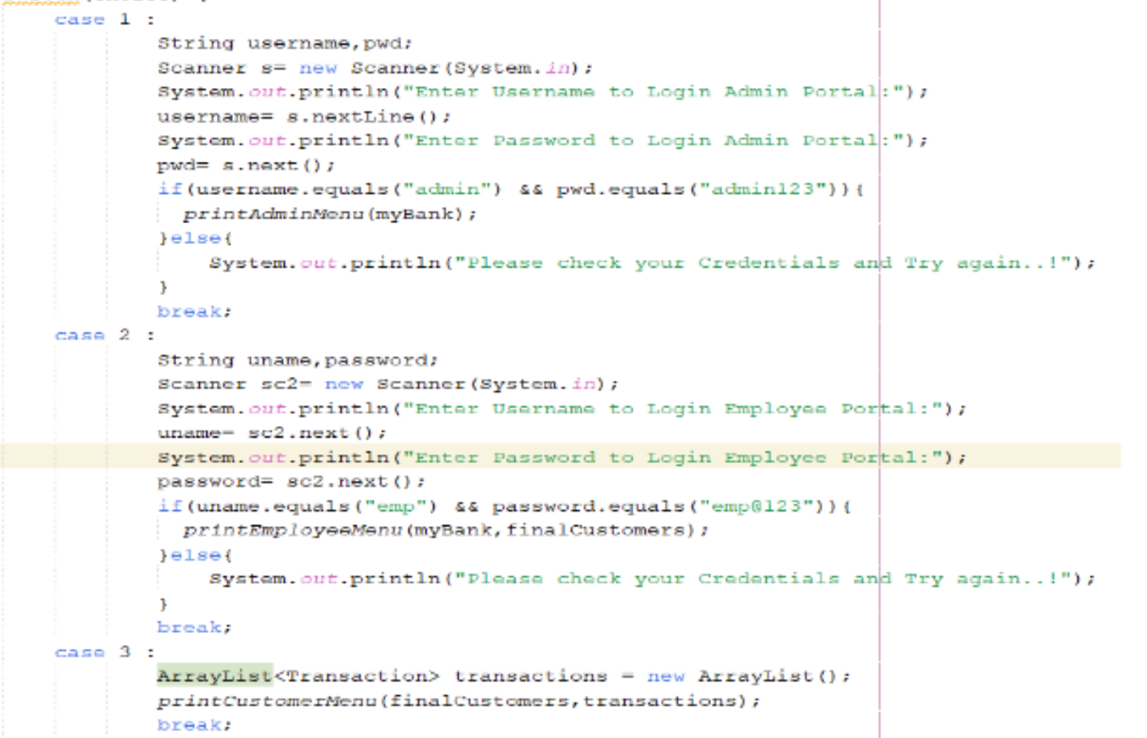
Switch/case is used to direct users to their proper interface

Slide 7
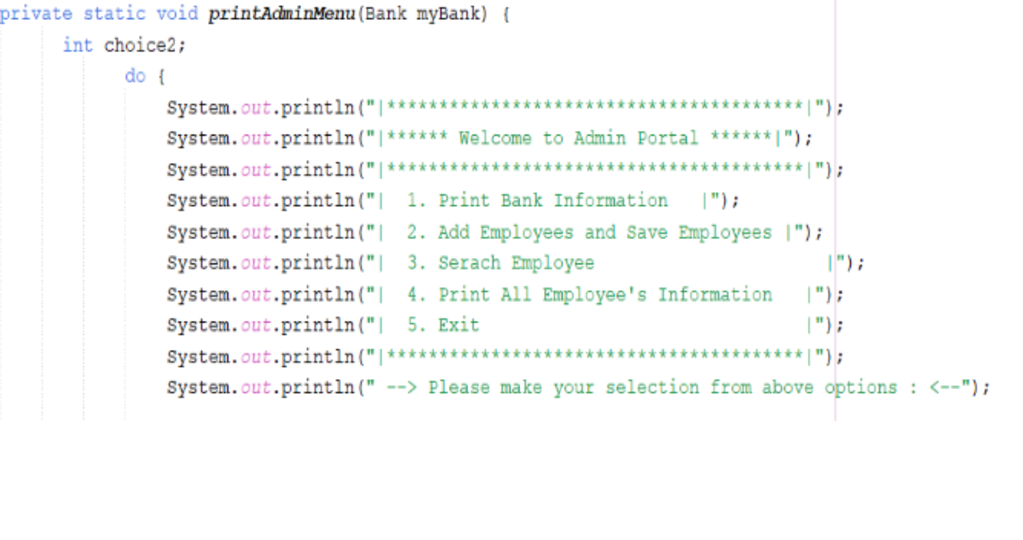

ADMIN MENU
Admin menu allows system admins to add/update employee information, and run reports on employees and bank information

Slide 8
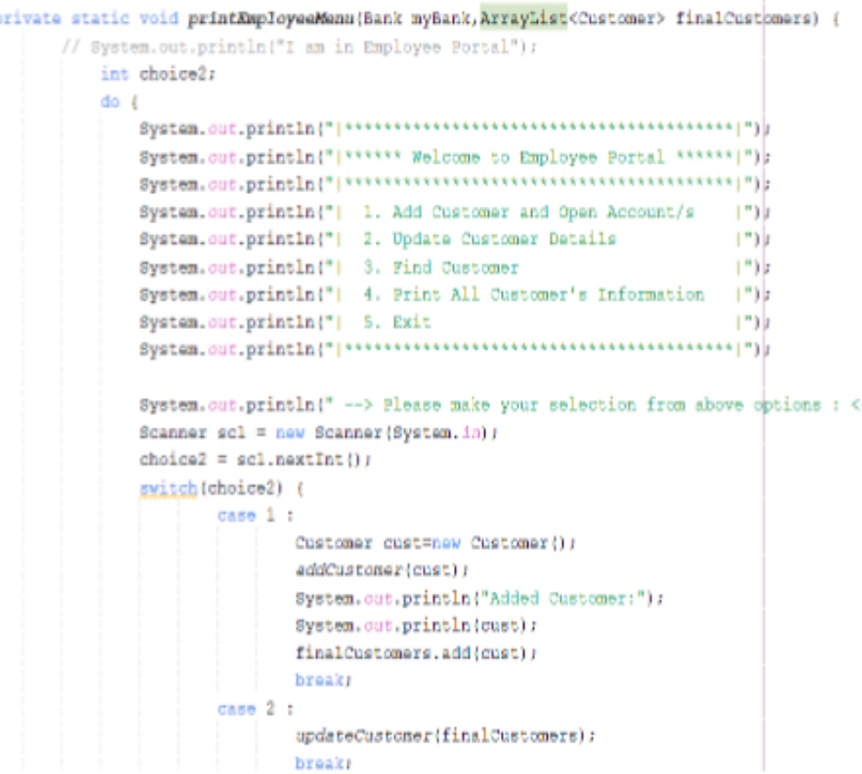

EMPLOYEE MENU
The employee menu has functions that assist customer-facing employees perform sales and customer service related duties

Slide 9
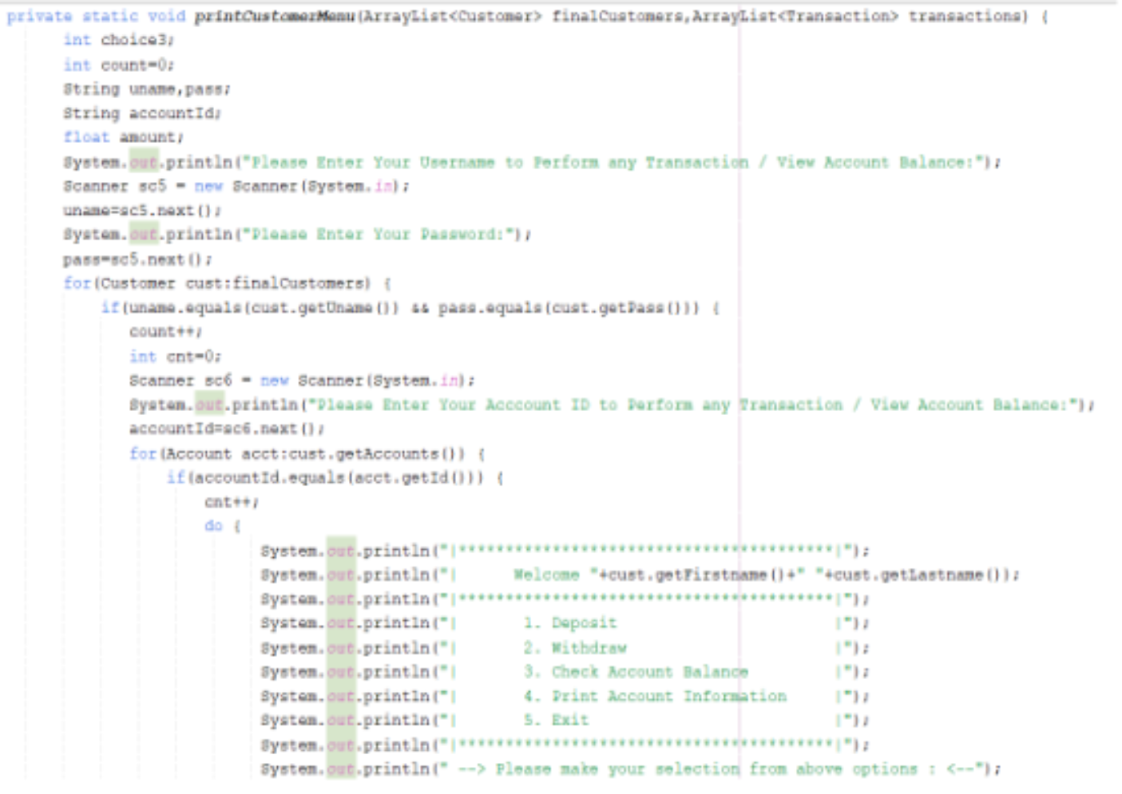

CUSTOMER MENU
The customer menu directs the customer to their account where they can view account details or perform transactions

Slide 10
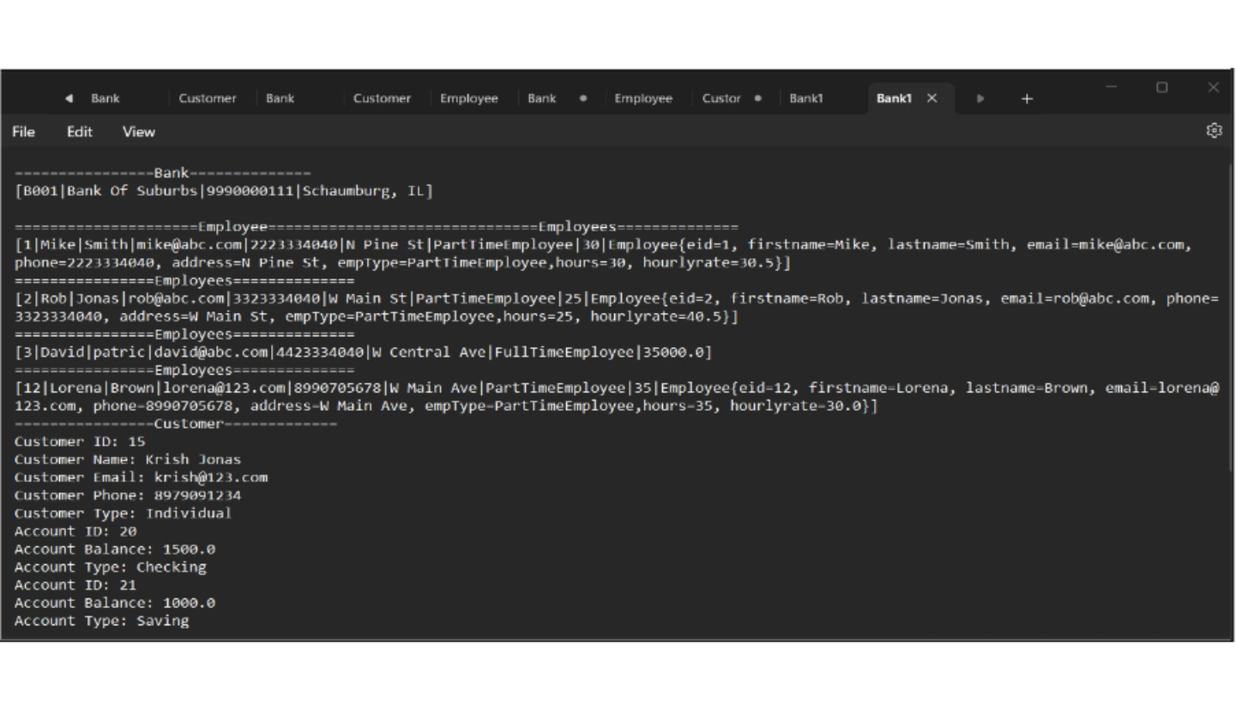
FILE WRITERS / BUFFER WRITER

Slide 11

ENJOY THE DEMO

Slide 12
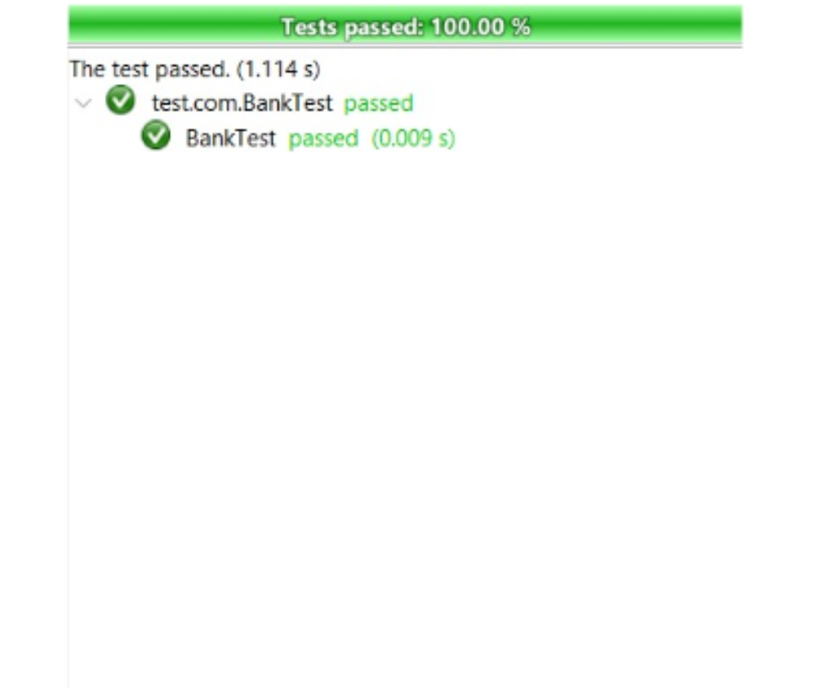
TEST CASES

Slide 13
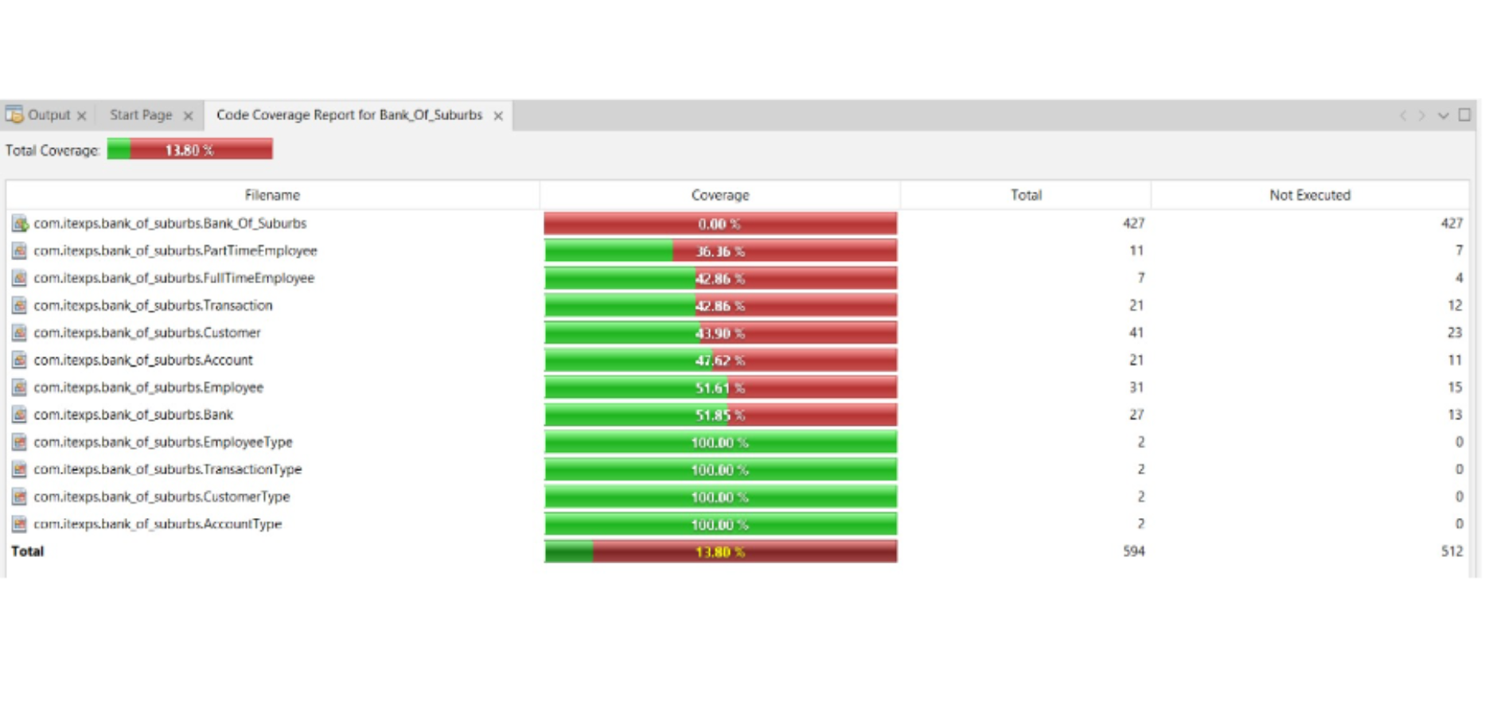
CODE COVERAGE REPORT

Slide 14

TOOLS
Google Drive
GitHub
Apache NetBeans
Draw.io
Java

Slide 15

FUTURE IMPROVEMENTS
Increased customer transaction types
Transfer between bank customers
External transfers to other banks
Mobile check deposit
Enhanced sales functionality for employees
Loan applications
Credit reports
Enhanced cybersecurity features
Add time delay if wrong username/password are entered 3 times consecutively
Hashing passwords to prevent cyber attacks from finding user credentials in database

Slide 16


THANK YOU!

